Slide 1

Orientation to Computing-I
L T P :2 0 0
www.lpu.in Lovely Professional University

Slide 2

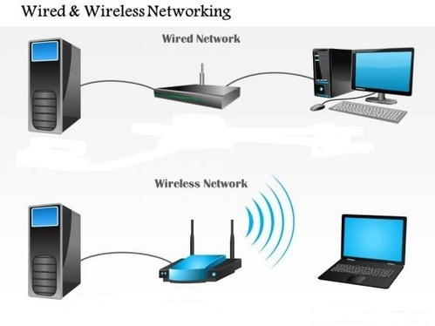
Types of Network
www.lpu.in Lovely Professional University

Slide 3
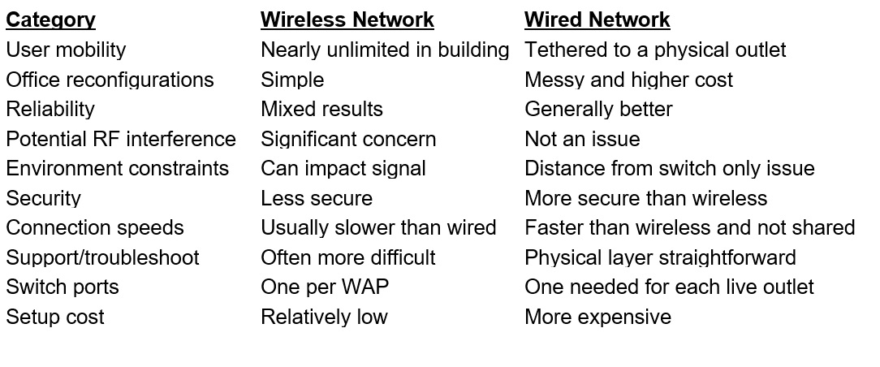
Types of Computer Network
www.lpu.in Lovely Professional University

Slide 4
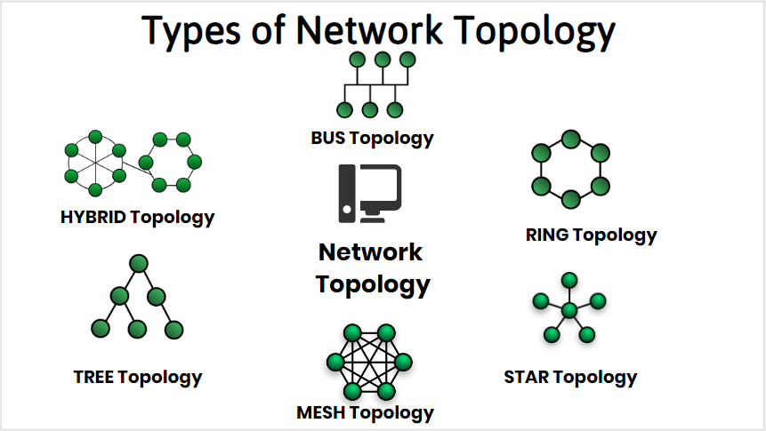
Network Topologies
www.lpu.in Lovely Professional University

Slide 5
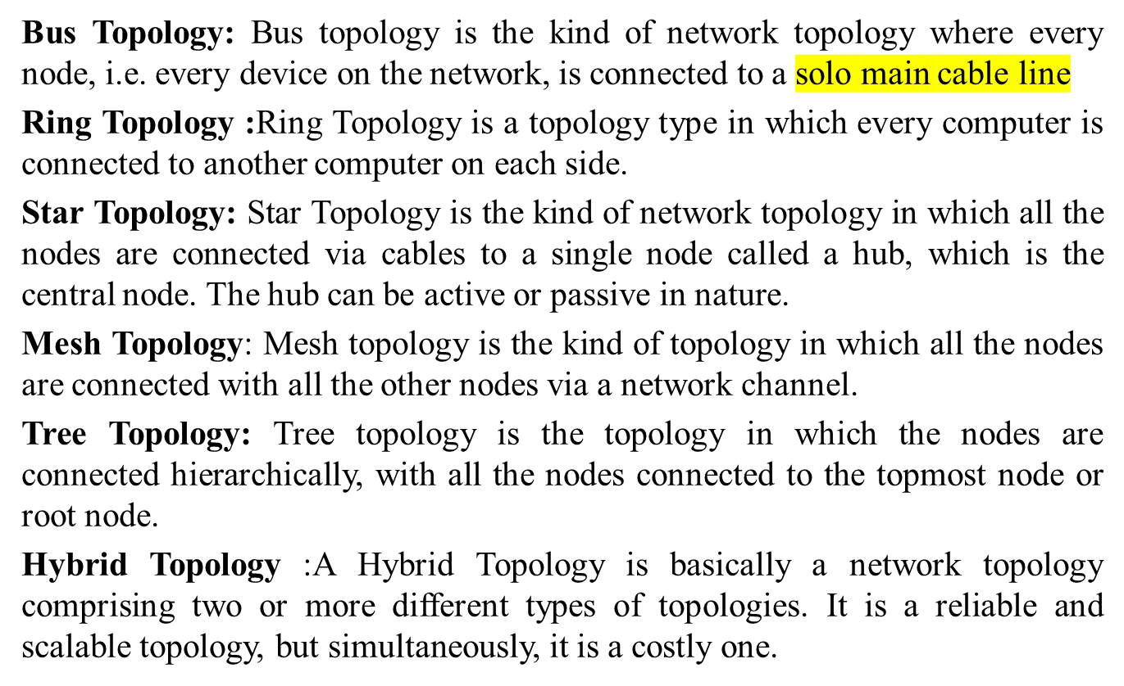
Types of Network Topologies
www.lpu.in Lovely Professional University

Slide 6

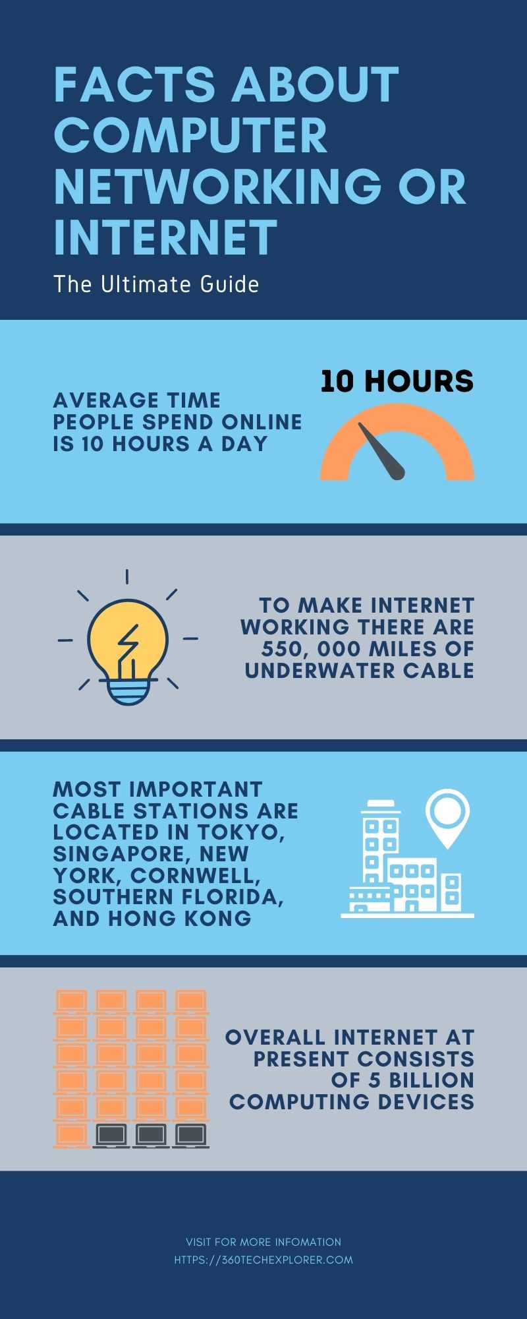
Notes:
The Internet consists of five billion computing devices such as computers, phones, modems, switches, routers, etc

Slide 7
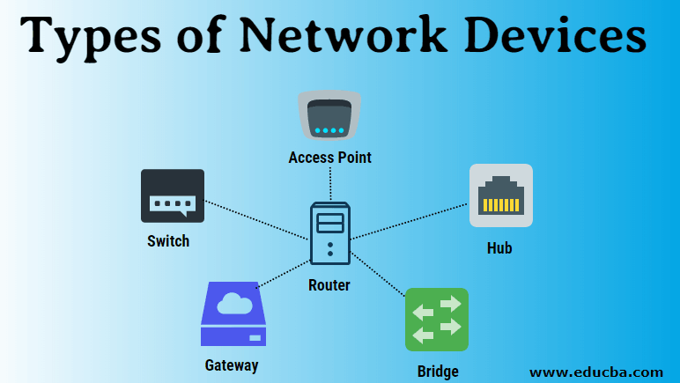
Network Communication Devices
There are different types of network devices through which the transmission occurs. These devices act as intermediates between the source and destination. These devices are also sometimes referred to as nodes or hosts and paths to find out the best paths which help them for communication.
Router: It is also known as a layer-3 device of the Open Standard Interface (OSI) model. It adds the source and destination address with the data packets it receives. This facilitates the data packets to easily reach to their corresponding destination.
www.lpu.in Lovely Professional University

Slide 8
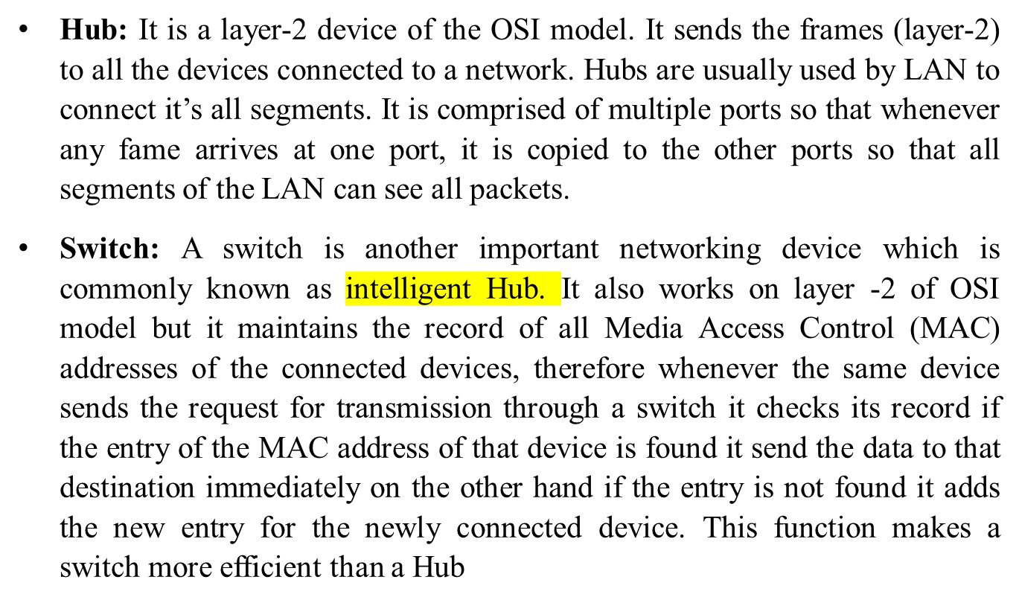
Network Communication Devices
www.lpu.in Lovely Professional University

Slide 9
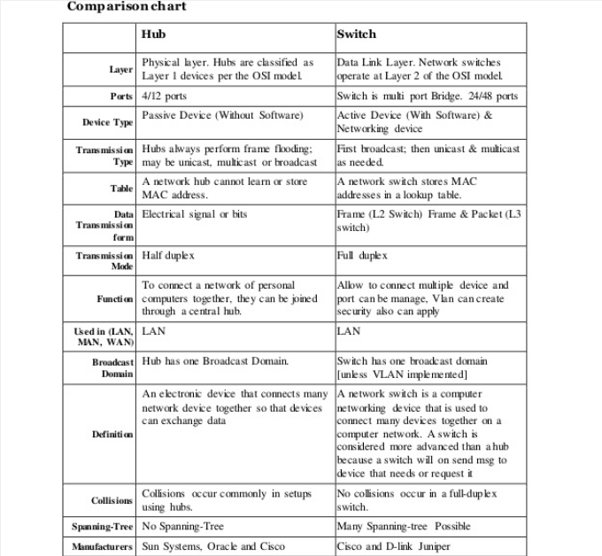
Difference

Slide 10
Network Communication Devices
Modems: It is a device that enables a computer to send or receive data over telephone or cable lines. The data stored on the computer is digital whereas a telephone line or cable wire can transmit only analog data. The main function of the modem is to convert digital signal into analog and vice versa..
Access Points: It is a device that creates a wireless local area network, or WLAN, usually in an office or large building. An access point connects to a wired router, switch, or hub via an Ethernet cable, and projects a Wi-Fi signal to a designated area.
www.lpu.in Lovely Professional University

Slide 11
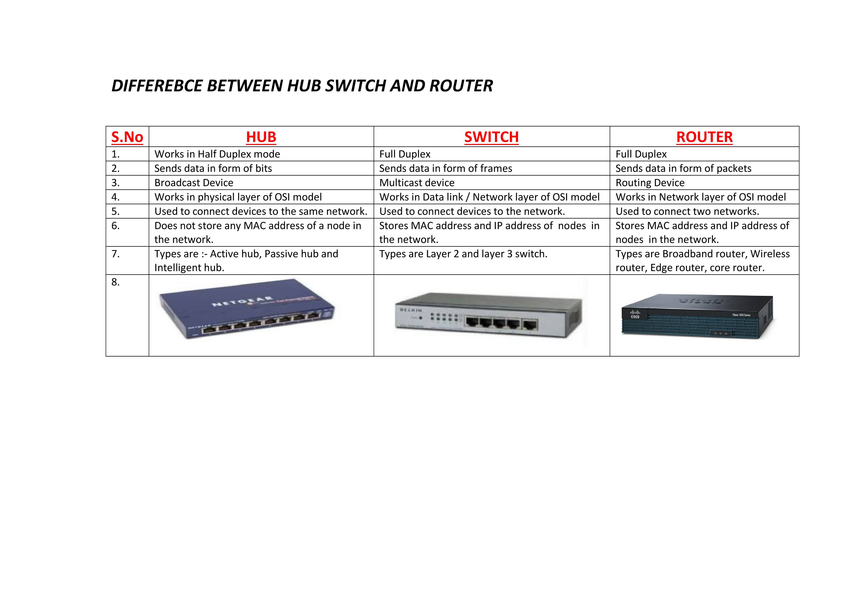
Difference
www.lpu.in Lovely Professional University

Slide 12
Activity-1
Show in packet tracer how topologies and networks work by sending data packets/ simple execution at tutor’s end……
www.lpu.in Lovely Professional University

Slide 13

Approximately 204 million emails per minute are sent over the Internet. 70% of them are spam

Slide 14
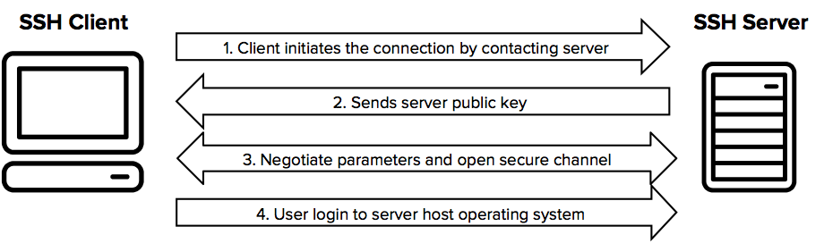
Secure Socket Shell (SSH)
SSH, also known as Secure Shell or Secure Socket Shell, is a network protocol that gives users, particularly system administrators, a secure way to access a computer over an unsecured network.
SSH also refers to the suite of utilities that implement the SSH protocol.
Secure Shell provides strong password authentication and public key authentication, as well as encrypted data communications between two computers connecting over an open network, such as the Internet.
www.lpu.in Lovely Professional University

Slide 15
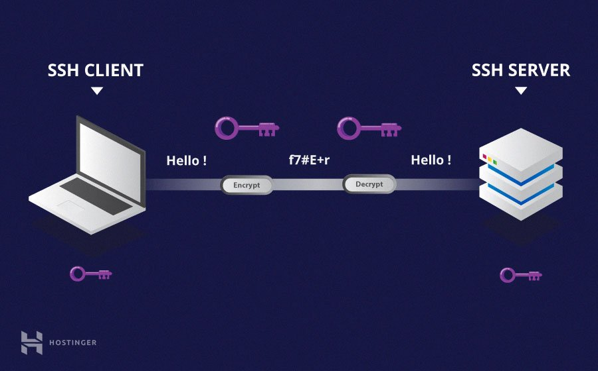
Understanding Different Encryption Techniques
www.lpu.in Lovely Professional University
Notes:
https://www.hostinger.com/tutorials/ssh-tutorial-how-does-ssh-work

Slide 16
Wireless Security
Wireless network security is the process of designing, implementing and ensuring security on a wireless computer network.
It is a subset of network security that adds protection for a wireless computer network.
Wireless network security primarily protects a wireless network from unauthorized and malicious access attempts.
Typically, wireless network security is delivered through wireless devices (usually a wireless router/switch) that encrypts and secures all wireless communication by default.
Even if the wireless network security is compromised, the hacker is not able to view the content of the traffic/packet in transit. Moreover, wireless intrusion detection and prevention systems also enable protection of a wireless network by alerting the wireless network administrator in case of a security breach
www.lpu.in Lovely Professional University

Slide 17
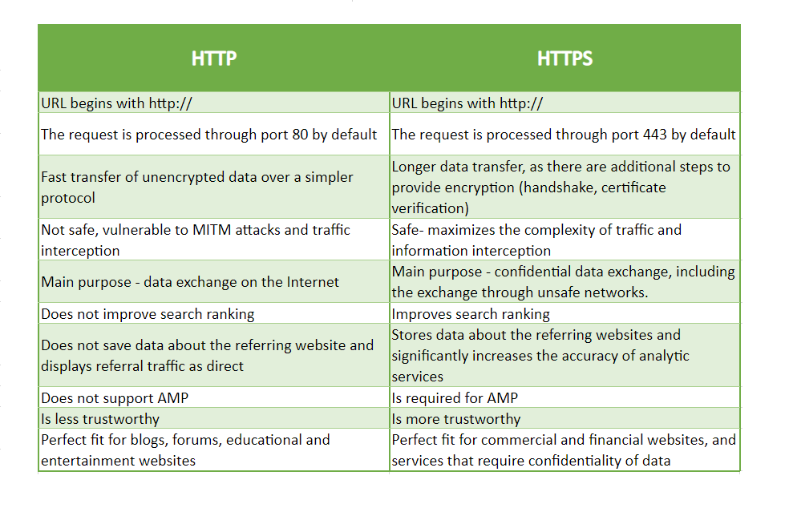
HTTP vs HTTPs
www.lpu.in Lovely Professional University

Slide 18
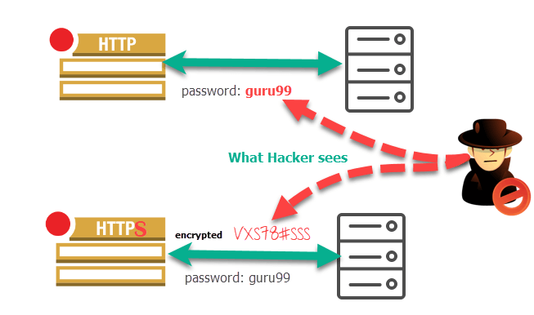
HTTP vs HTTPs
www.lpu.in Lovely Professional University

Slide 19
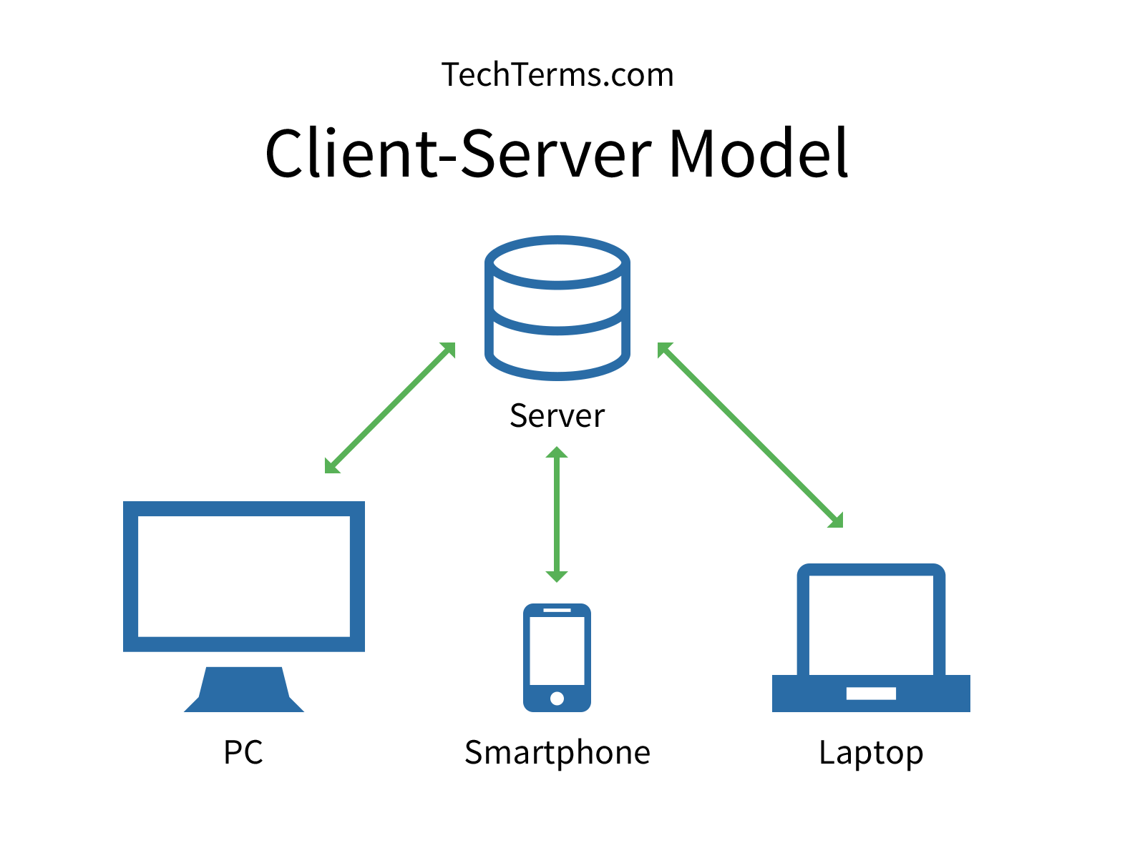
Client Server Model
The Client-server model is a distributed application structure that partitions task or workload between the providers of a resource or service, called servers, and service requesters called clients.
In the client-server architecture, when the client computer sends a request for data to the server through the internet, the server accepts the requested process and deliver the data packets requested back to the client. Clients do not share any of their resources. Examples of Client-Server Model are Email, World Wide Web, etc.
www.lpu.in Lovely Professional University

Slide 20
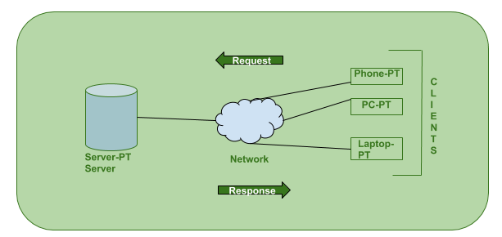
Working of Client Server Model
The Client-server model is a distributed application structure that partitions task or workload between the providers of a resource or service, called servers, and service requesters called clients.
In the client-server architecture, when the client computer sends a request for data to the server through the internet, the server accepts the requested process and deliver the data packets requested back to the client. Clients do not share any of their resources. Examples of Client-Server Model are Email, World Wide Web, etc.
www.lpu.in Lovely Professional University
Notes:
https://www.geeksforgeeks.org/client-server-model/

Slide 21
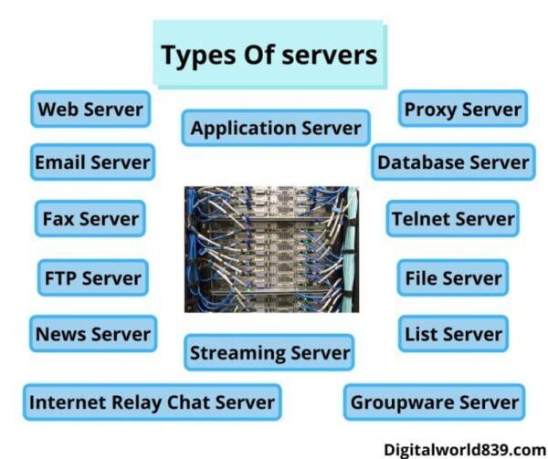
www.lpu.in Lovely Professional University

Slide 22
Types of Server
Proxy server commonly called “proxy”. It acts as a gateway between users and the internet. These types of servers are used for performance enhancement, privacy, and anonymous surfing. When a client connects to a proxy server and requests a service, its accessing IP address changes.
Application Server is a framework, it is an environment where applications run. Application Server includes a server operating system (OS) and server hardware that provides computing-intensive operations and other services to the application.
A web server is a server that runs on websites. It is also called a computer program. The main function of web servers is to store, process, and deliver.Whenever we search on the internet through web browsers like chrome, Mozilla, internet explorer, etc, receives the request for the URL and then web server sends the data according to the need of the user. These types of servers mainly show the data in format like images, text, video, etc.
www.lpu.in Lovely Professional University

Slide 23
Types of Server
A file server is a network that helps to transfer stored files. The file server stores and manages all the files in a computer and sends a copy of the file to the other computer on the request of the users. It shares the storage of computer files such as documents, sound files, photographs, images, databases, etc. These types of servers is used mainly on the local network.
A database server runs a database management system and provides database services to clients. The server manages data access and retrieval and completes clients’ requests.
Server synchronization allows to synchronize the database of two servers located on different systems. In this way, several servers can be synchronized with each other one after the other.
www.lpu.in Lovely Professional University

Slide 24
Types of Server
A log server is a log file automatically created and maintained by a server consisting of a list of activities it performed. It maintains a huge server requests.
Information about the request, including client IP address, request date/time, the page requested, HTTP code, bytes served, user agent, and referrer are typically added to the log server format.
This data can be combined into a single file, or separated into distinct logs, such as an access log, error log, or referrer log. server logs typically do not collect user-specific information.
These files are usually not accessible to general Internet users, only to the administrative person of Internet service.
A statistical analysis of the server log may be used to examine traffic patterns by time of day, day of the week, referrer, or user agent.
www.lpu.in Lovely Professional University
Notes:
https://medium.com/softifybd/what-is-a-log-server-and-why-it-is-important-ff1df13fac87

Slide 25
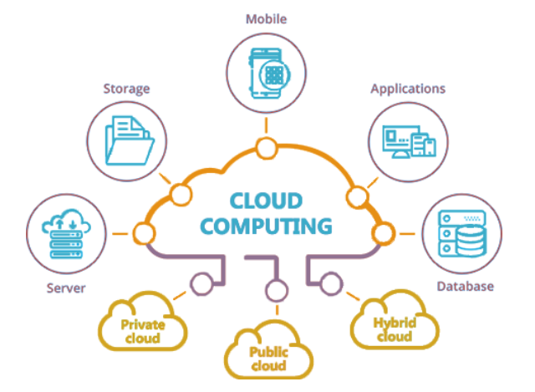
Cloud Computing
Cloud computing is the on-demand delivery of IT resources over the Internet with pay-as-you-go pricing. Instead of buying, owning, and maintaining physical data centers and servers, you can access technology services, such as computing power, storage, and databases, on an as-needed basis from a cloud provider like Amazon Web Services (AWS).
www.lpu.in Lovely Professional University

Slide 26
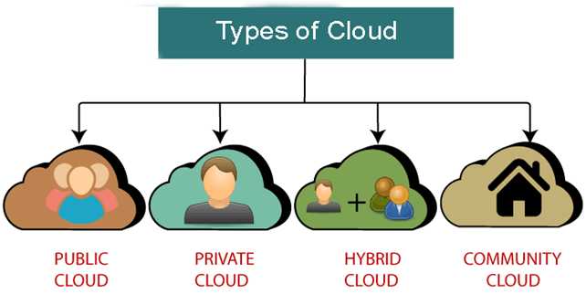
Types of Cloud
Public cloud is open to all to store and access information via the Internet using the pay-per-usage method.
Private cloud is also known as an internal cloud or corporate cloud. It is used by organizations to build and manage their own data centers internally or by the third party.
Hybrid Cloud is a combination of the public cloud and the private cloud.
Community cloud allows systems and services to be accessible by a group of several organizations to share the information between the organization and a specific community.
www.lpu.in Lovely Professional University

Slide 27
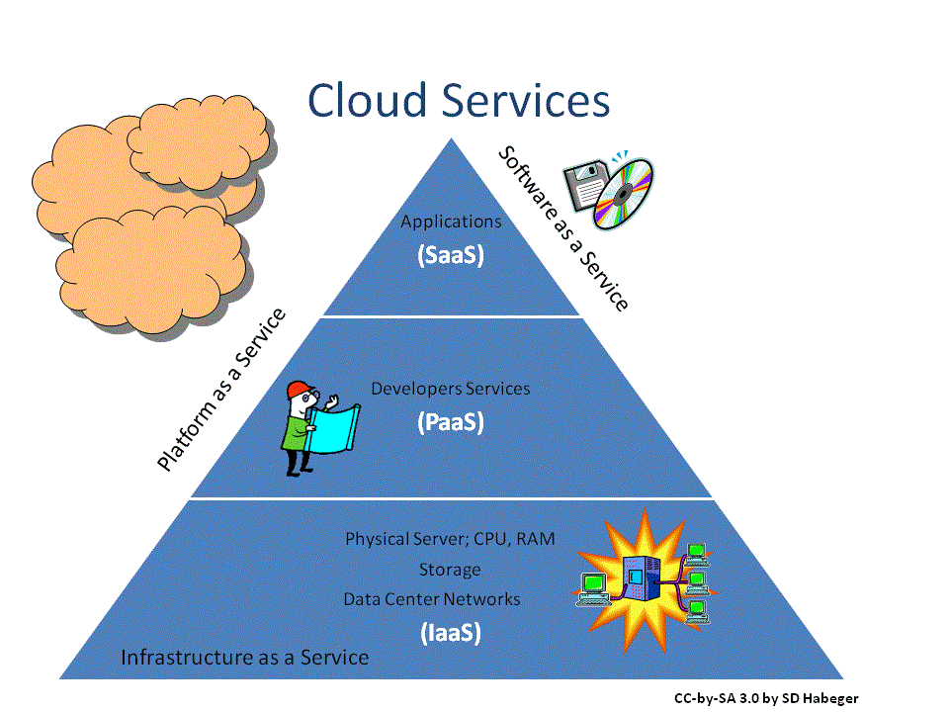
Cloud Service Models
www.lpu.in Lovely Professional University

Slide 28
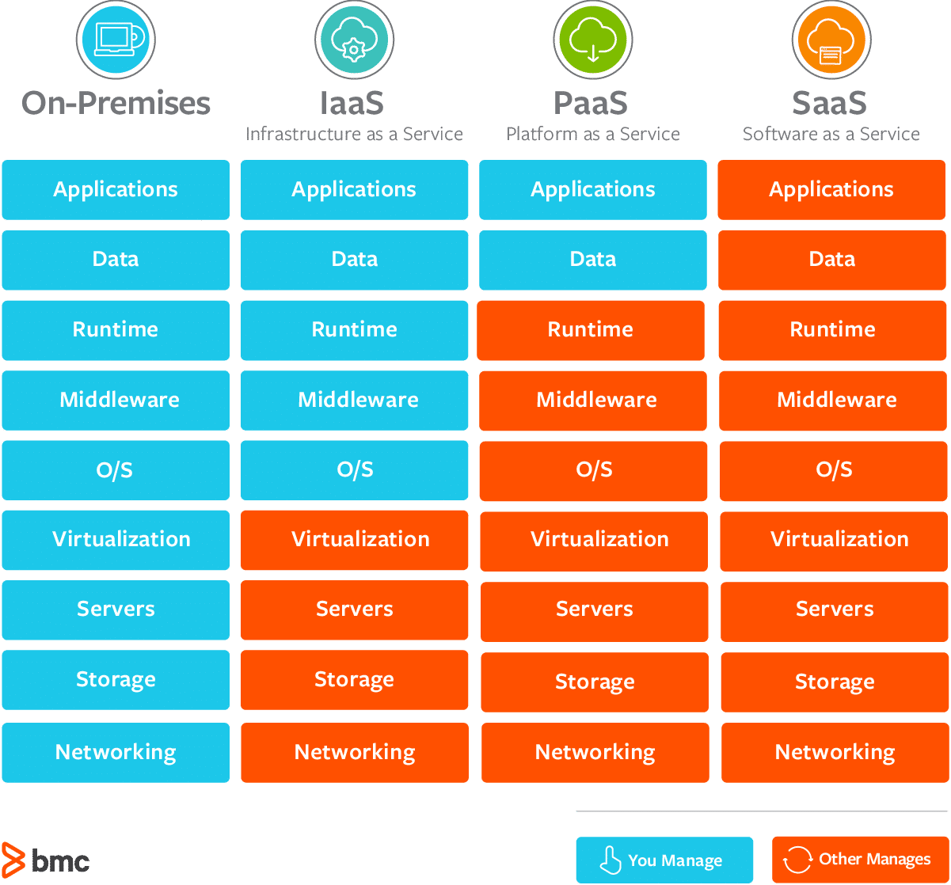
Comparison of Cloud Service Models
www.lpu.in Lovely Professional University

Slide 29
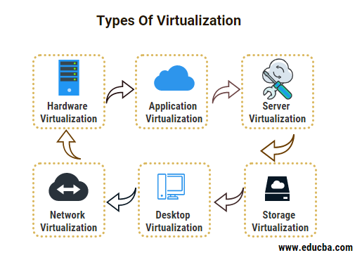
Types of Virtualization
Virtualization is the technology to generate virtual instances of computer resources for multiple uses of the same physical resource. There are several virtualization technologies available that are capable of virtualizing the server, storage, networks, and operating systems.
www.lpu.in Lovely Professional University

Slide 30
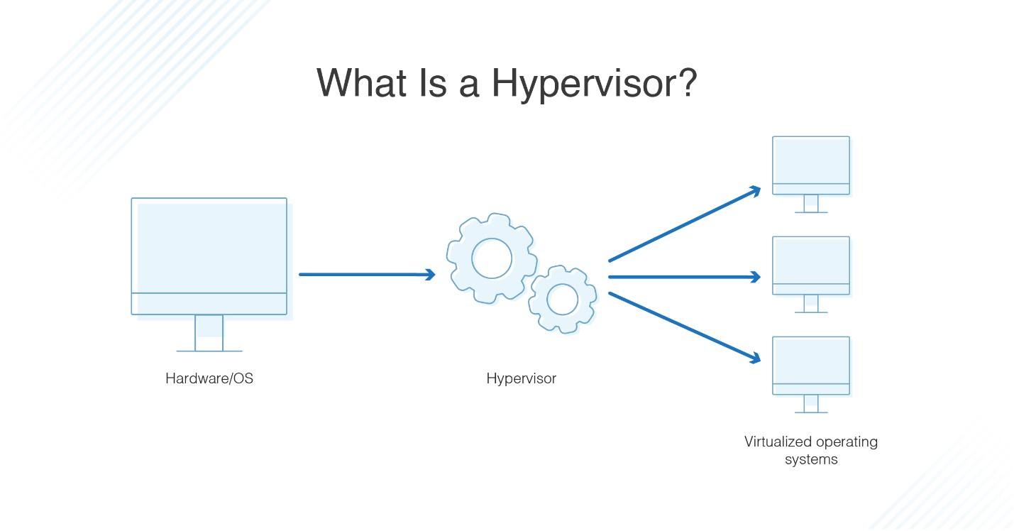
Hypervisor
A hypervisor is hardware, software, or firmware capable of creating virtual machines and then managing and allocating resources to them. Virtual machines are machines set up to use the resources of the host machine.
www.lpu.in Lovely Professional University

Slide 31
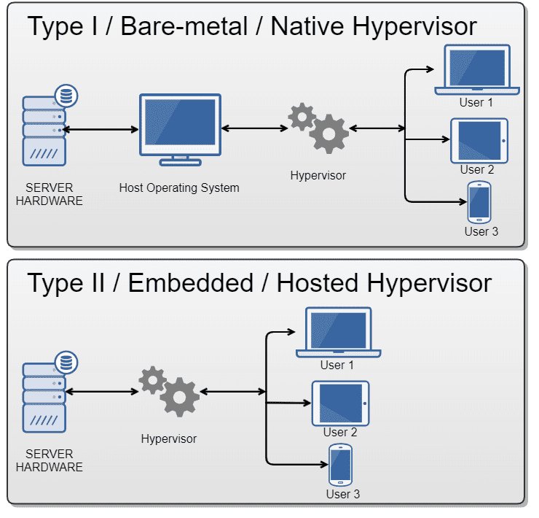
Types of Hypervisor
www.lpu.in Lovely Professional University

Slide 32
How Does a Hypervisor Work?
They operate on the server level and can be either physical or virtual, and hardware or software-defined.
They load the client operating systems of the VMs.
It distributes the computing resources such as CPU, memory, bandwidth, and disk storage for each of the VMs. It does this by creating pools of hardware resources, which it then allocates to VMs.
VMs can create requests for the hypervisor through API calls.
www.lpu.in Lovely Professional University

Slide 33
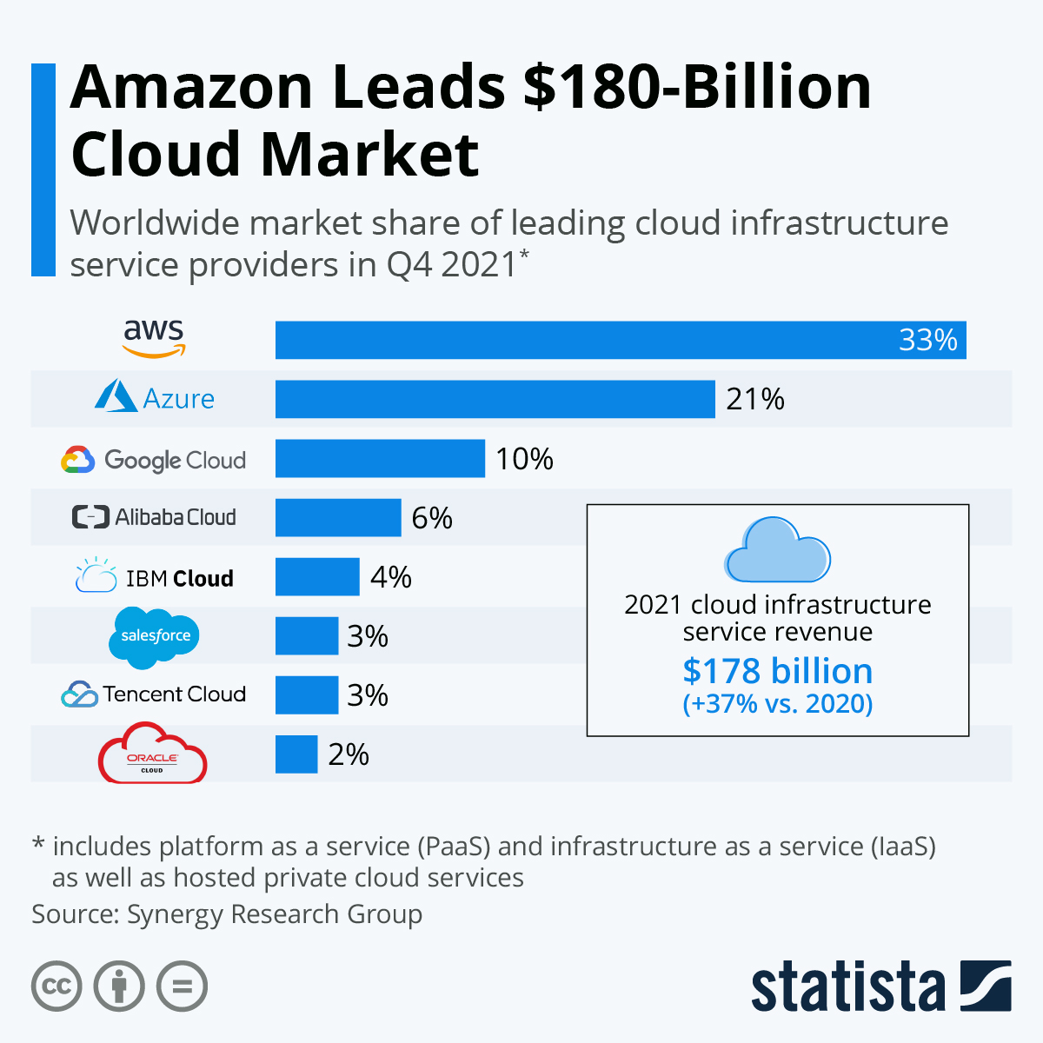
World Wide Cloud Market
www.lpu.in Lovely Professional University

Slide 34
Activity
Discussion on different websites such as google docs, mail, etc for reference of concepts

